Slide 1
Design and Fabrication of Interactive Autonomous Robot as a Research Platform : Robomuse3.0
Supervisor : Prof. S.K. Saha
Examiner : Prof. S. Mukherjee
By : Vishal Mehta : 2010ME10693
Gaurav Kumar : 2010ME10673

Slide 2
Introduction and Objective
Design and fabricate a 24x7 operational, autonomous mobile robot
Prior attempts: Robomuse 1.0, Robomuse 2.0
Project Objectives
Study of previous development in this direction at IIT Delhi
Eliminate existent problems in previous design of ROBOMUSE
Make a detailed CAD model of improved version ROBOMUSE 3.0
Fabricate and test the newly designed robot
Achieve 90% reliability and low maintenance
Theme: Object based pick and place functions

Slide 3
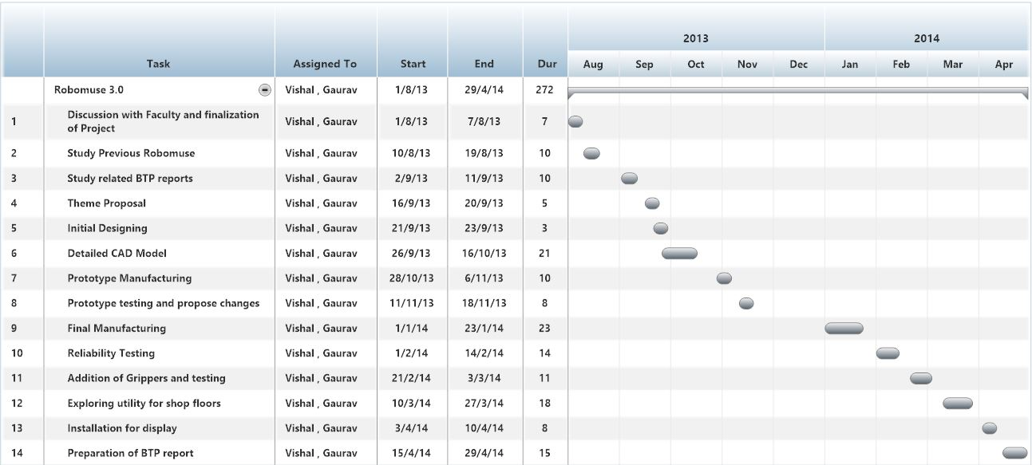
Gantt Chart

Slide 4
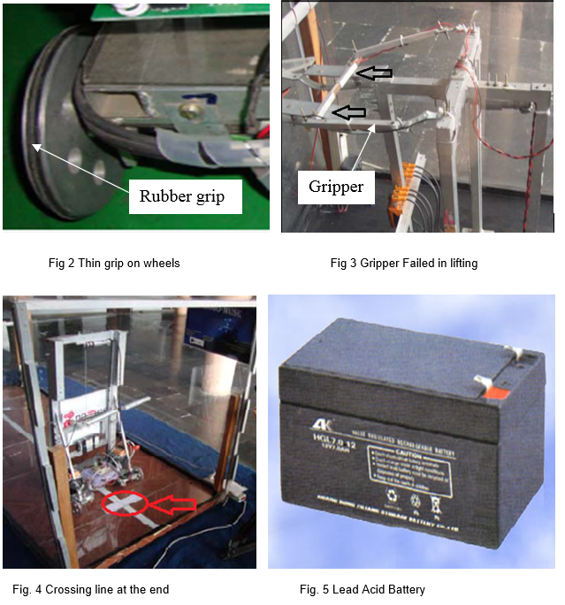
Progress Made
Study prior attempts in this direction at IIT Delhi
Identify all possible problems and sources of error and eliminate them
Mechanical problems
Electrical problems
General problems

Slide 5
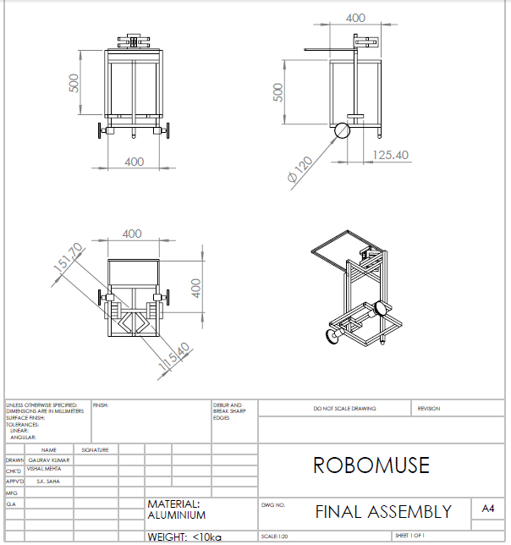
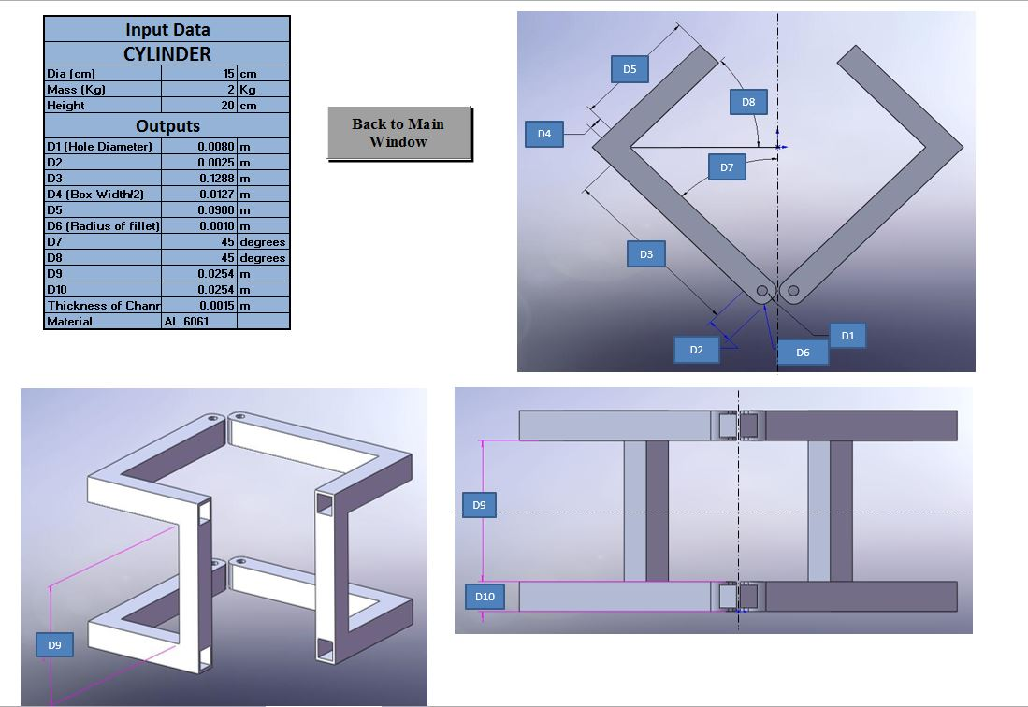
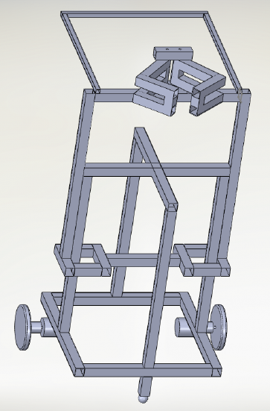
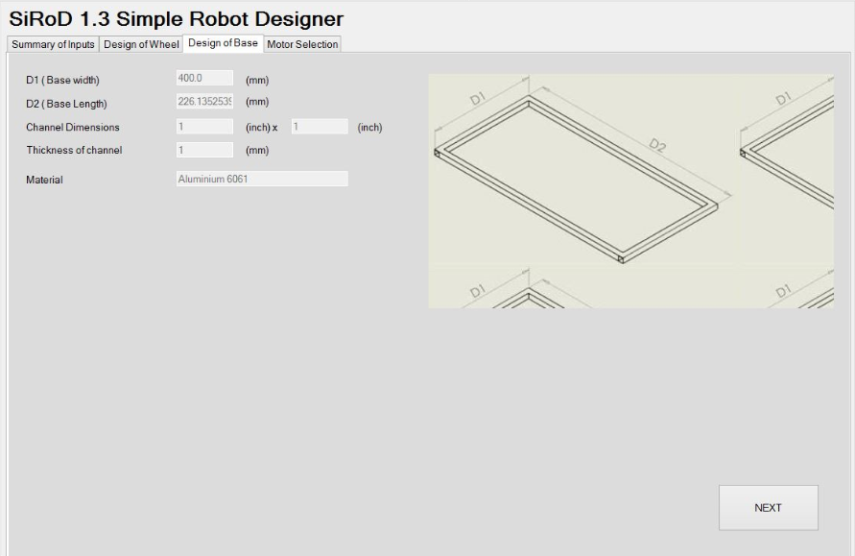
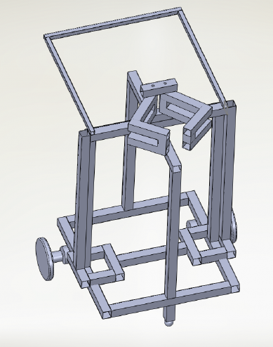
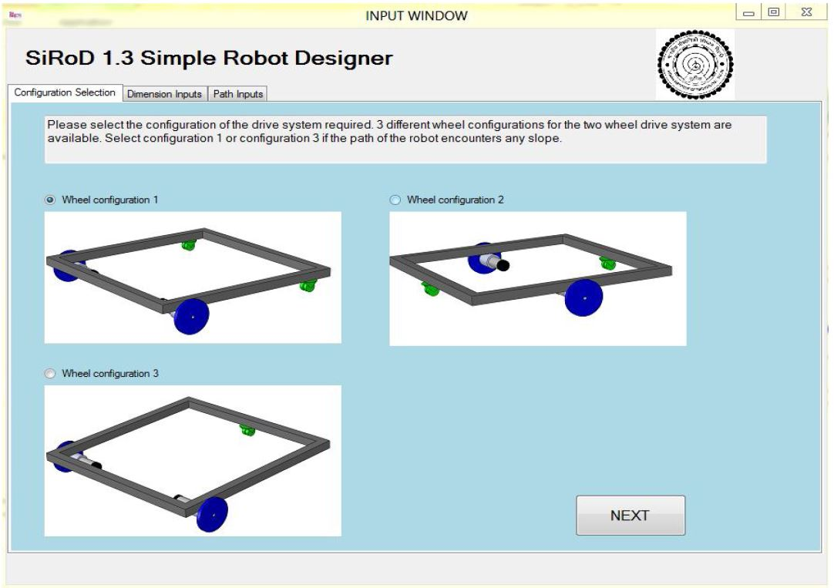
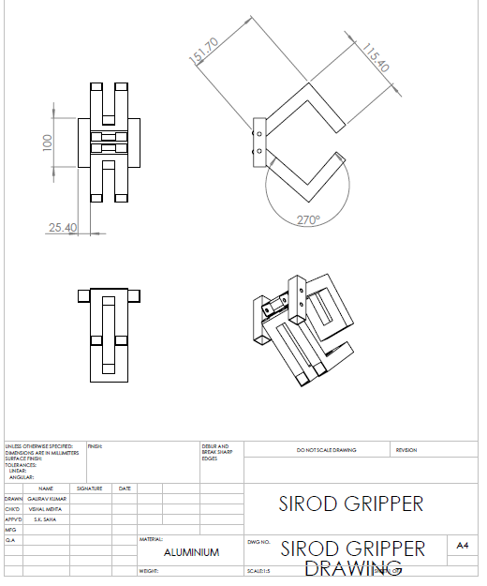
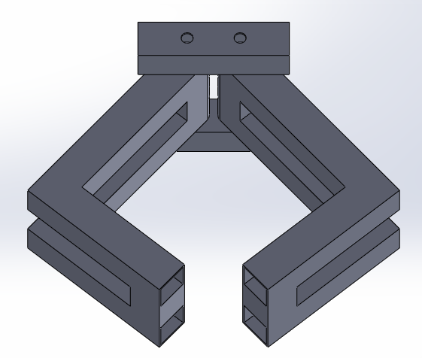
Progress Made…
Studied BTP reports on gripper design and base dimension to avoid toppling
Designed gripper using software SIROD 2.0
Made CAD model of gripper
Performed toppling analysis using software SIROD 2.3
Made CAD model of previous ROBOMUSE with new gripper

Slide 6
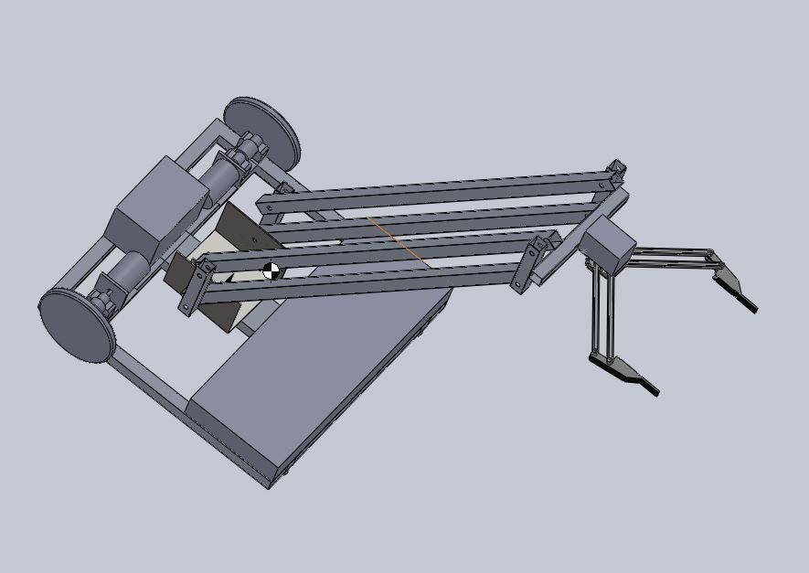
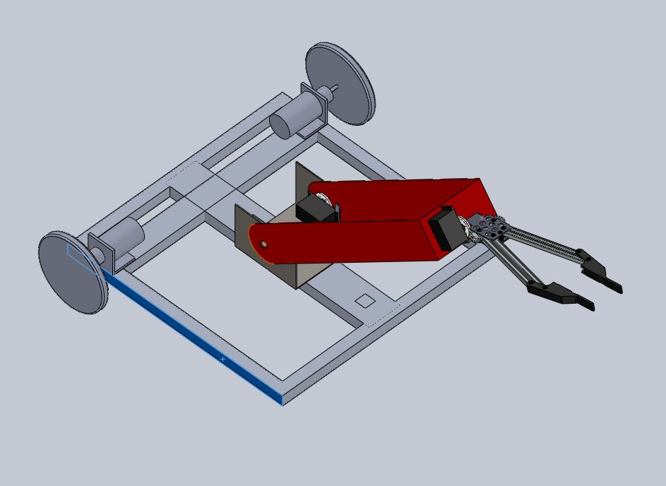
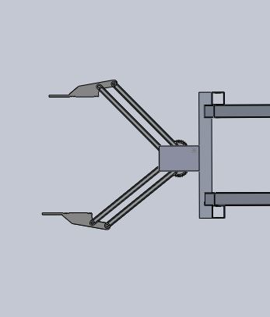
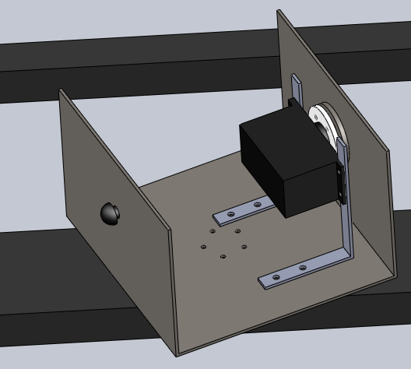
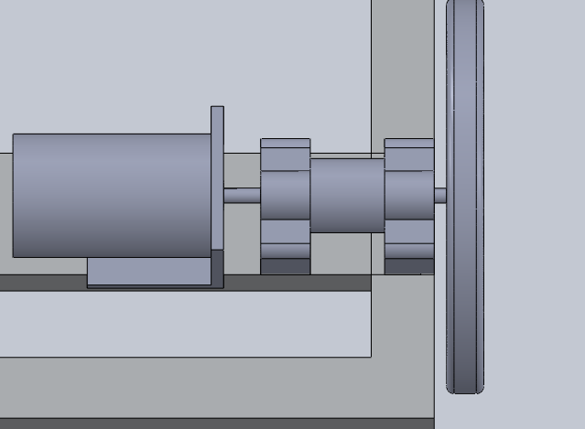
Progress Made…
Designed gripper with:
Smaller footprint
Chamfered exterior fingers
Minimum finger length
Designed two different gripper arms
Turn-table for moving arm
Motor mounting using two bearings and spring coupler
Theoretically calculated torque and RPM requirement of motors

Slide 7
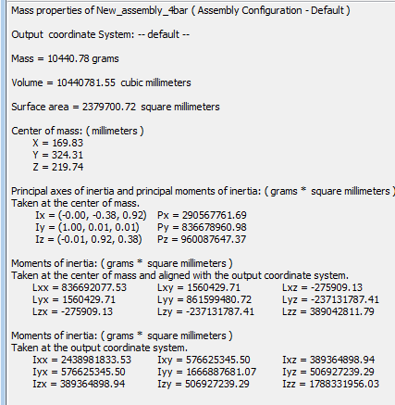
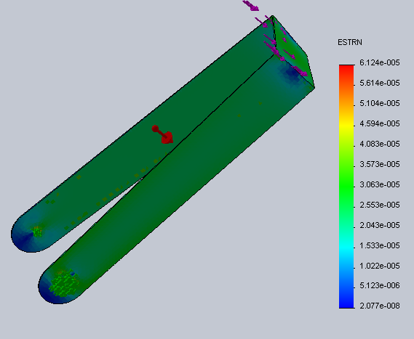
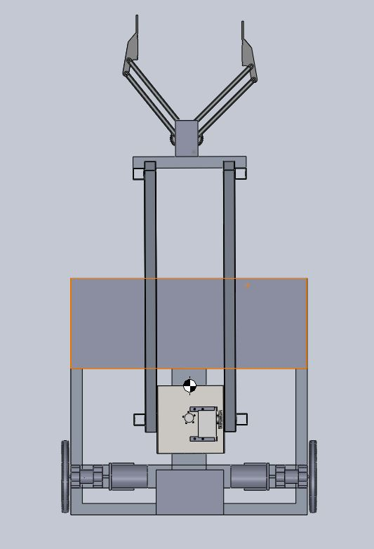
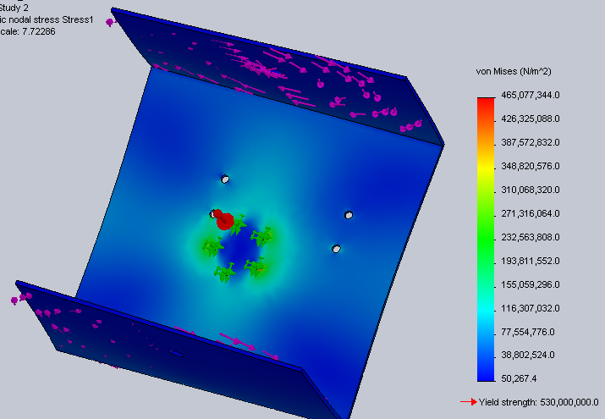
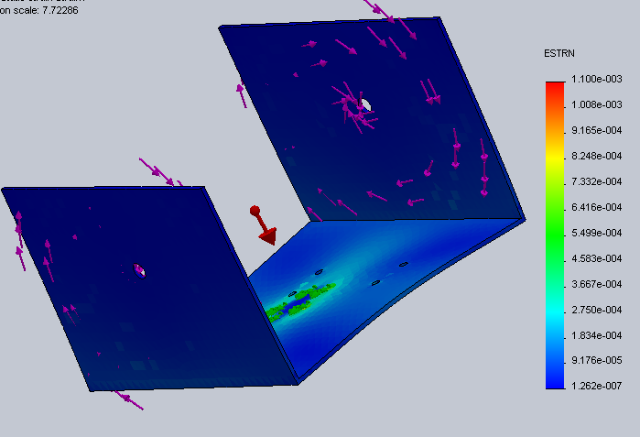
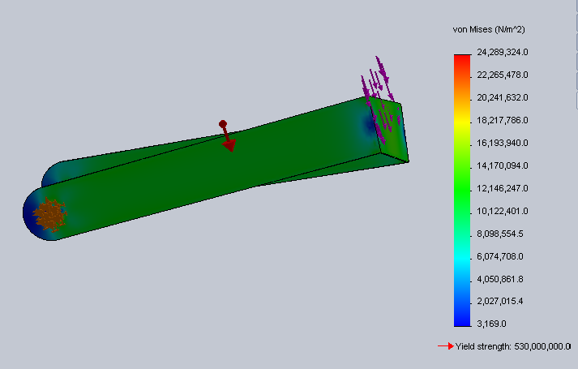
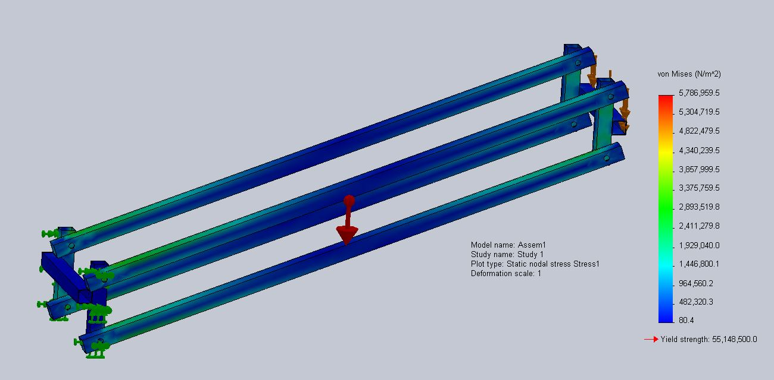
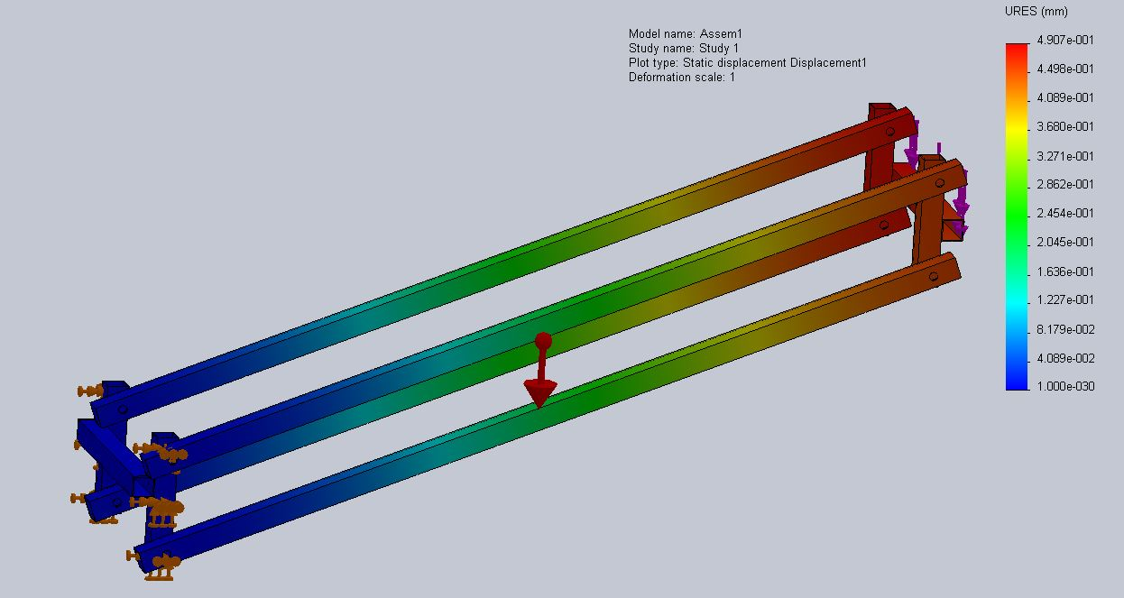
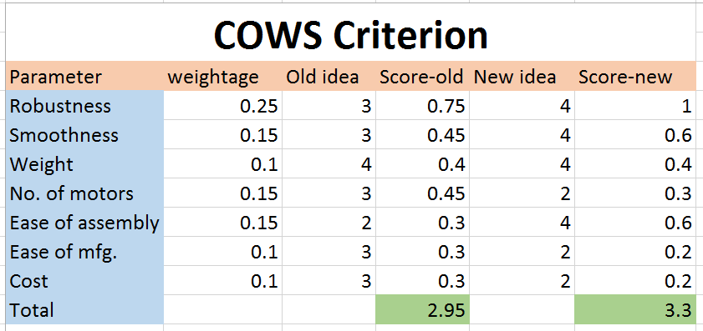
Progress Made…
Calculated mass properties, centre of mass & moments of inertia using CAD
Stress-strain analysis of critical parts in Solidworks
Finalized material and obtained FOS
Applied COWS method for finalizing design:

Slide 8
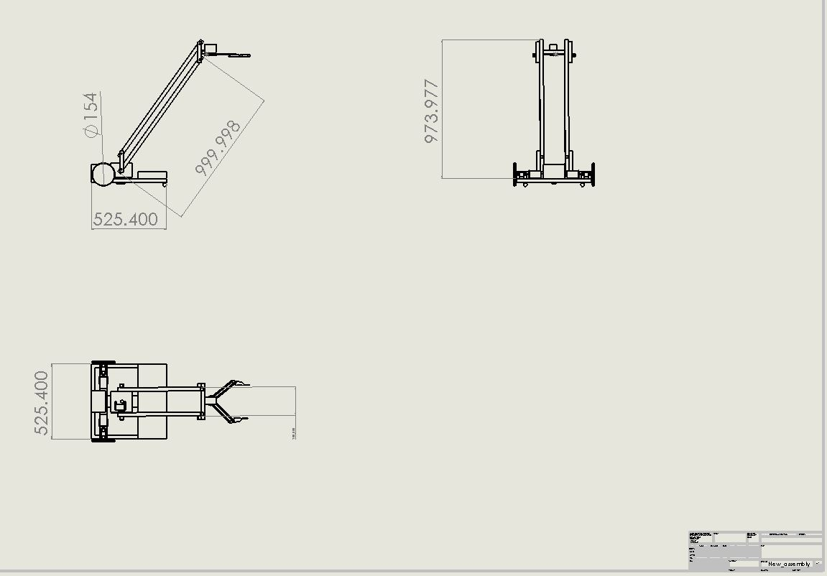

Slide 9
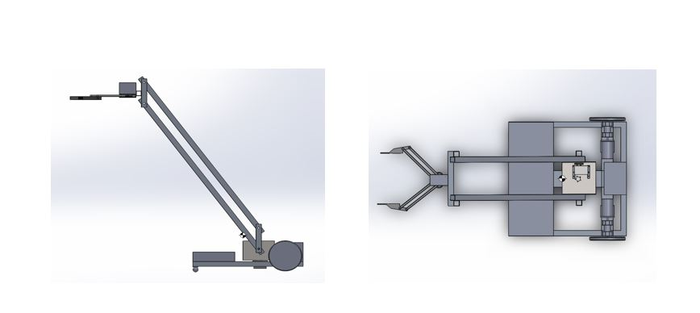

Slide 10
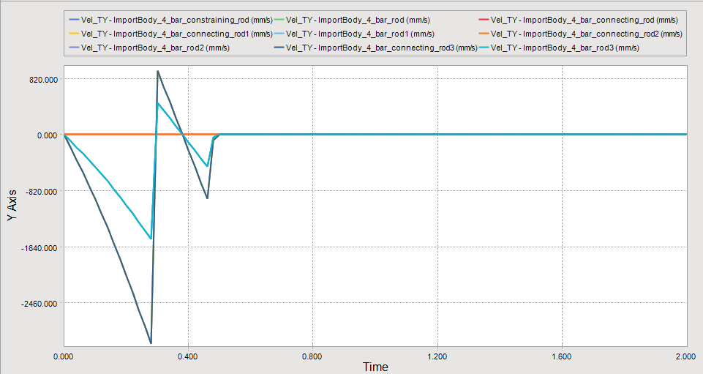
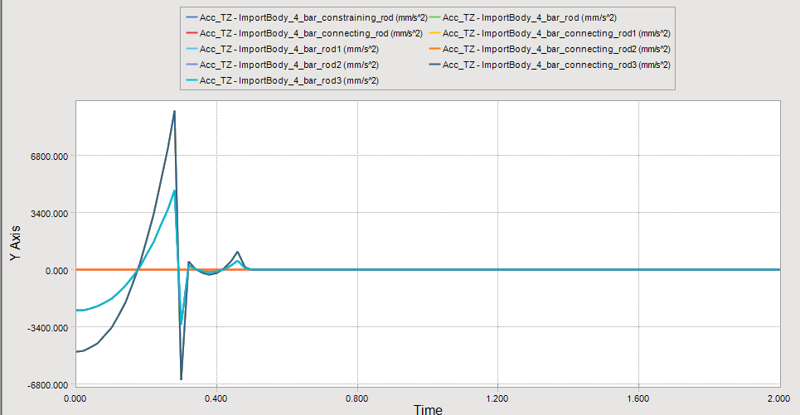
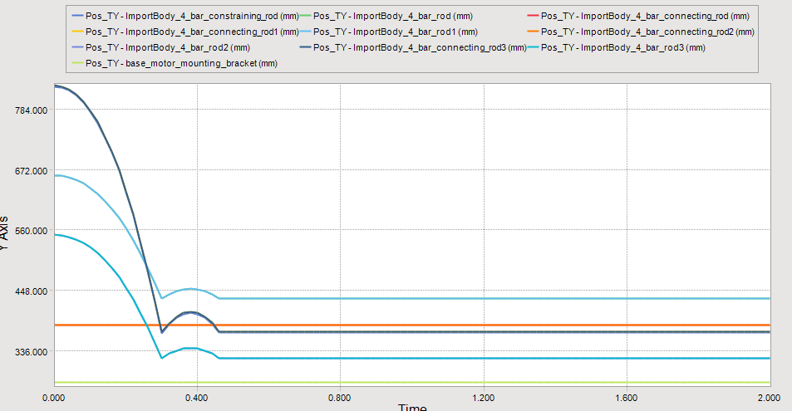
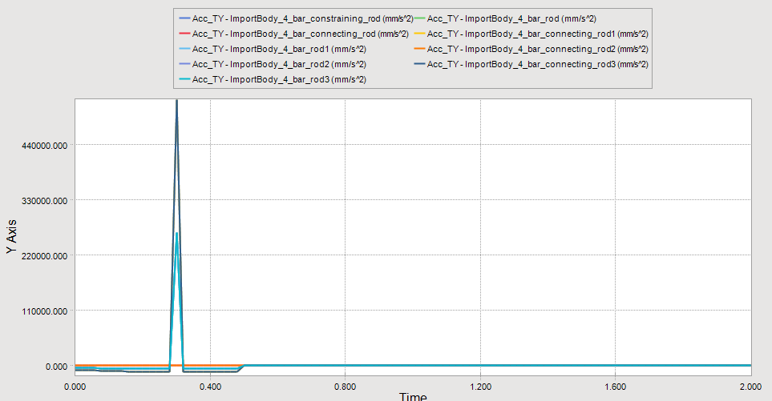
Progress Made…
Simulated complete motion of robot in field, check for errors
Performed dynamic simulation of robot in software RecurDyn
Obtained displacement, velocity and acceleration of all parts with time
Torque required by motors can be calculated
Fabricated prototype

Slide 11
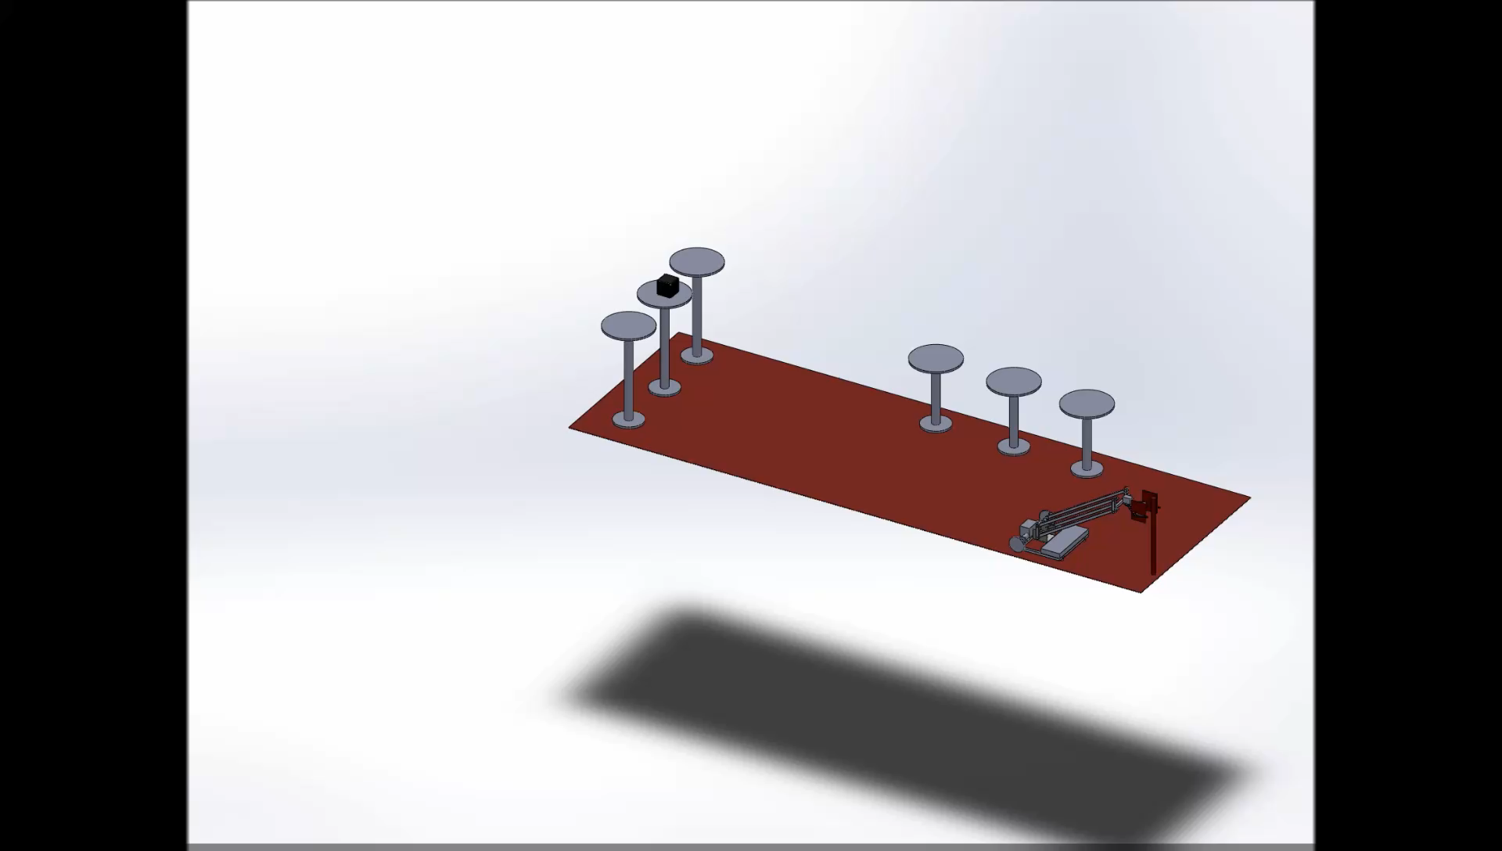

Slide 12
Thank You

